Slide 1
Feedback and Guidelines on Writing the Model Description and Methods
for the Communication Skills component of ENME203 Project Part 3

Slide 2
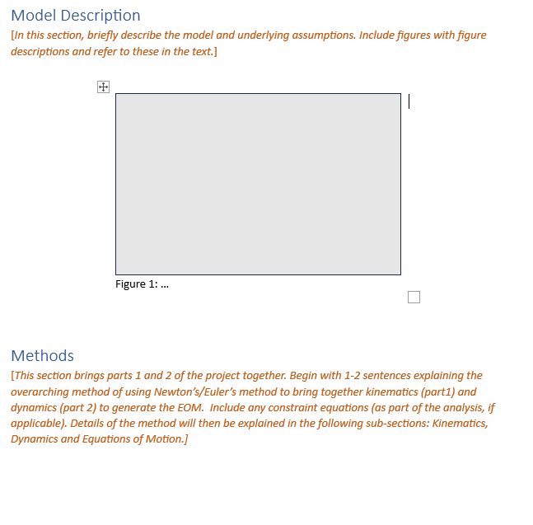
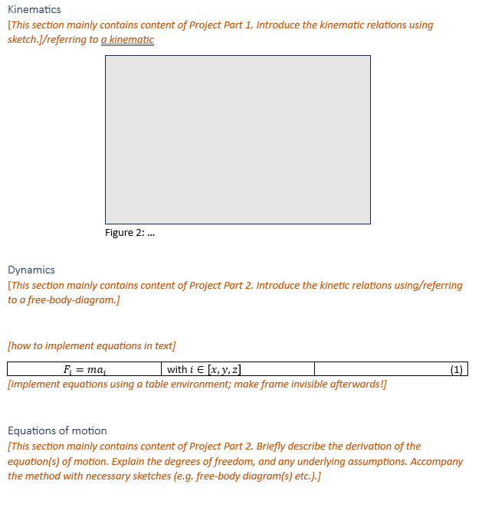
Following the brief (template) carefully will produce good results:

Slide 3
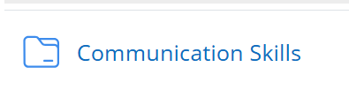
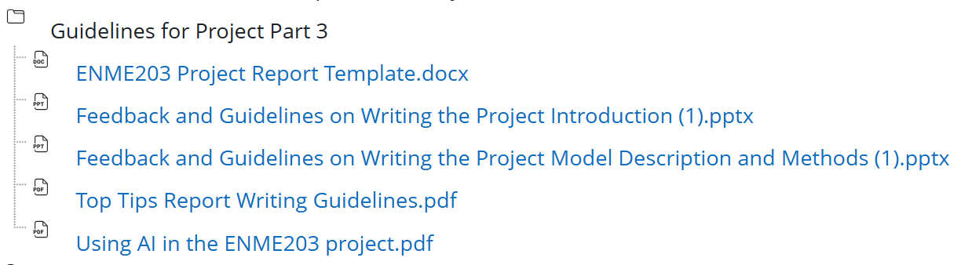
Following the Communication Skills Guidelines (under the Project tab) carefully will produce good results:
Attach this GenAI declaration to the end of the template when submitting.

Slide 4
Feedback compiled from the optional Model and Method sections students submitted:
Format
Name the submission helpfully (Walker Part 3) (not ‘FinalFinalFinaldraft’).
Submit a PDF version.
Delete all traces of the template.
Remove the brackets in the header.
When a citation is at the end of a sentence and refers to content from that sentence, the full stop goes after the brackets, like this [1].
Do not include hand-drawn sketches.
Give the source for every figure, unless it is your own creation. Cite using [ x ]. Include the source in the reference list.
Follow all guidelines given on format, such as those in the Communication Skills folder.

Slide 5
Feedback compiled from the optional Model and Method sections students submitted:
Professional Writing:
Avoid contractions (aren’t – are not, don’t – do not, etc).
Avoid vague phrases (for a long time, in many ways, some ).
Avoid informal language (majorly, cool, random).
Refer to the ‘project/study/research’ advancing the research or achieving an aim or purpose – not the ‘report’.
Avoid bullet points.
Use paragraphs.
Check punctuation and use a spell checker or grammar software.
Follow all guidelines given, such as those in the Communication Skills folder.

Slide 6
Feedback compiled from the optional Model and Method sections students submitted:
Content:
Respond to every part of the brief. That’s it, really.
Also, remember that there is no need here to include the ‘working out’ from Project Part 1. Use the results from that work to answer the brief for writing the Model and Methods. This is short and sweet and straightforward, without unnecessary extras.

Slide 7
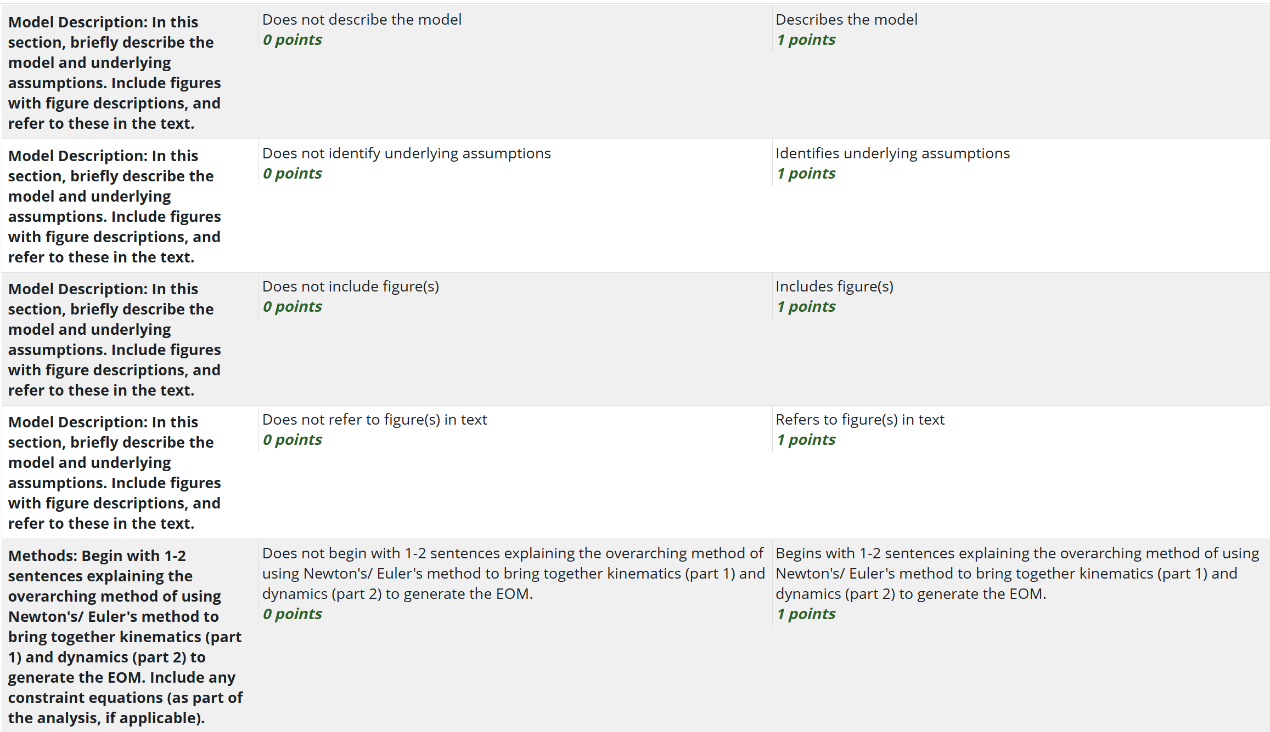
Here is the marking rubric used for Model and Method (* Point values will change for Part 3. I reserve the right to tweak it slightly for Part 3.)

Slide 8
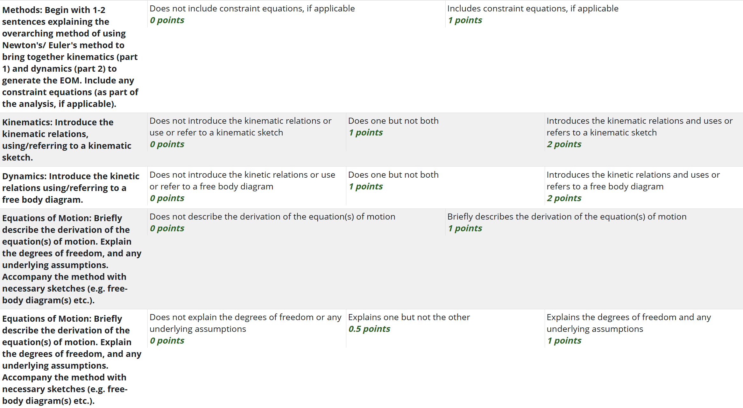
Here is the marking rubric used for Model and Method (* Point values will change for Part 3. I reserve the right to tweak it slightly for Part 3.)

Slide 9
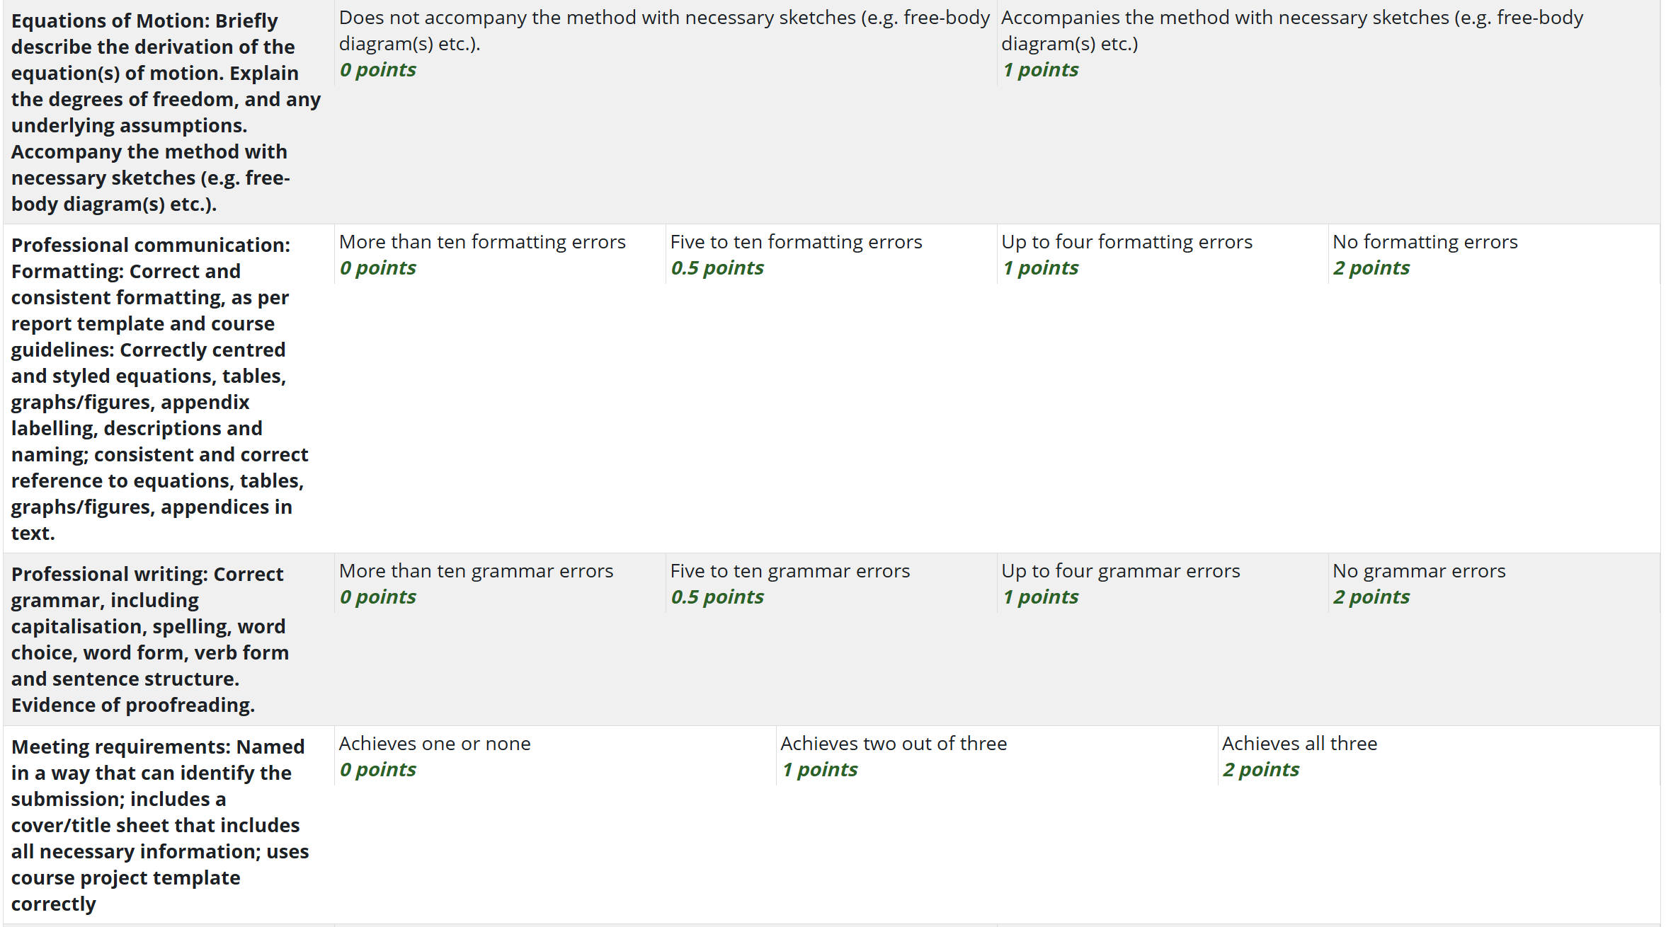
Here is the marking rubric used for Model and Method (* Point values will change for Part 3. I reserve the right to tweak it slightly for Part 3.)

Slide 10
And, if you have questions, please ask!
Christine.walker@canterbury.ac.nz

